Slide 1
Why Blood Transfusions for Nursing Facility Residents Should be Administered at the Resident’s Bedside in the Skilled Nursing Facility (SNF) and NOT in an Acute Care Hospital
A Request for a Demonstration Model to prove the quality of care improvements and
Medicare cost saving available by offering blood transfusions at the bedside in SNFs

Slide 2
Background: How did we get here?
Medicare & Medicaid signed in 1965 and blood transfusions only paid for in the hospital setting
While other services have adapted (i.e. Ventilator Care) the delivery of blood transfusions is still locked to the hospital location strictly because of reimbursement regulations
Despite the fact that blood transfusions can be safely and effectively provided at the bedside in an SNF and eliminate the many negative medical risks of admitting a vulnerable senior to the hospital, this service is not reimbursed in the SNF setting
Because the Medicare skilled reimbursement includes blood transfusions, when a nursing home sends a Medicare Part A patient to a hospital outpatient setting to their blood transfusion, the SNF is responsible for the cost. If they admit them however, Medicare pays for the transfusion and the SNF “saves” money

Slide 3
Background: How did we get here?
In 2016 a select group of long term care organizations realized the financial benefits of paying out of pocket to provide blood transfusions at the patient’s bedside allowing them to continue billing Medicare and to avoid significant lost revenue
In 2016 a total of 547 Medicare Part A residents received blood transfusions at their bedside saving Medicare over $7 million dollars
While the financial model works for Medicare Part A residents it does not work for Medicaid long term care residents. They must still be admitted to the hospital
We now have a two-tier system where Medicare Part A residents can receive blood transfusions at their bedside while Medicaid long term care residents must be admitted to the hospital to receive the exact same service… this is not equitable!

Slide 4
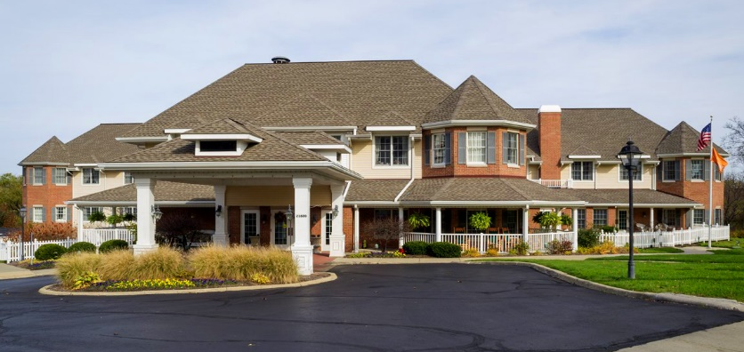
^{Current Medicaid Patient Flow} When A Medically Necessary Blood Transfusion Is Needed By A Maryland Medicaid Resident
^{Total Cost to Deliver} Blood Transfusions at Hospitals
^{Gertie is a Medicaid LTC} resident in a Maryland SNF in need of a medically necessary blood transfusion.
^{Ambulance:} ^{$1,000} ^{Acute Care: $13,200} Medicare Part A Skilled: ??????? Cost of treating delirium, etc. ??????? ^{Total Cost: $14,200 *}
*Does not include any costs for Medicare Skilled or cost of treating post acute issues resulting for stay
^{Gertie is transported from} ^{nursing facility to the local} hospital at a cost of $500 where she is admitted as a Medicare patient.
Gertie is transported from the hospital back to the SNF at a cost of $500 and as a Medicare Part A patient until her skilled care needs end and she converts back to Maryland Medical.
4.2 days ALOS and medical costs of over $13,000
If just one Maryland Medicaid resident per facility per quarter required a blood transfusion, by administering those transfusions in the SNF instead of the hospital, CMS could save over $9 million dollars a year and the resident would avoid the many negative side effects so common when a vulnerable nursing home resident is hospitalized”.

Slide 5
Risk Factors of Admitting a Vulnerable Senior unnecessarily to the Hospital
Increased confusion
Increased risk of delirium
Skin breakdown
Incontinence
Exposure to hospital acquired infections

Slide 6
Recommendations
Authorize a Demonstration Model allowing Medicaid long term care residents to receive blood transfusion in the SNF without being hospitalized:
Eliminated inequity in the system
Improves quality for residents
Saves Medicare significant dollars
Include as part of the Demonstration a financial modeling showing the economic advantage for long term care providers with Medicare Part A patients to pay directly for their blood transfusions
Improves quality for residents
Saves Medicare significant dollars

Slide 7
Prepared by:
John Whitman, MBA, NHA
Executive Director
The TRECS Institute
johnwhitman@theTRECSinstitute.org
484-557-6980

